Slide 1

PROJECT TITLE : MEDISEND
GROUP: 1 CSE370 SEC: 8
MEMBERS :
RABITA JUNHAI 18101259
SAMIR RAHMAN 18101130
FARIZ BIN KAMAL 18101228
MD ESADUL HAQUE 17301148
SAIARA ZERIN NIBRAS 18101251

Slide 2
LOGIN PAGE

Slide 3
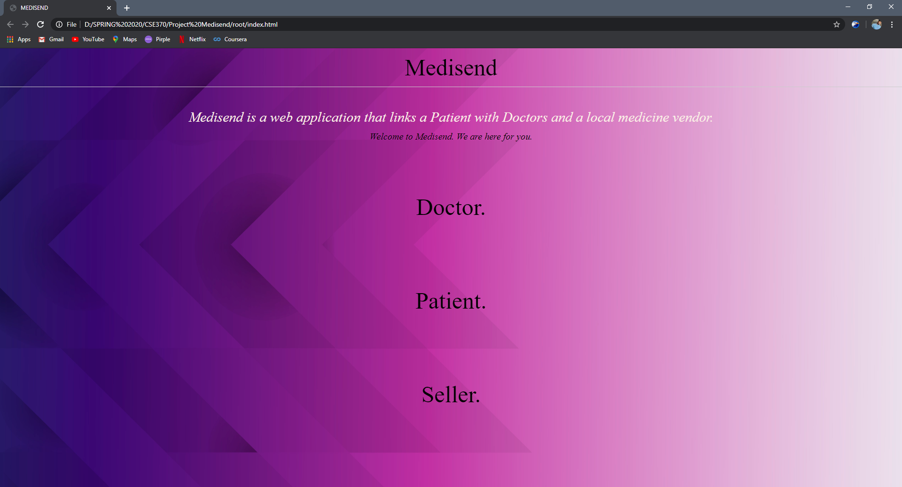
This is the homepage of our database. The homepage opens up to a simple log of three other link to the login pages of Doctor, Seller and Patient.
The first link refers to the Doctor’s login page.
The second link refers to the Patient’s login page.
The third link refers to the Seller’s login page.

Slide 4
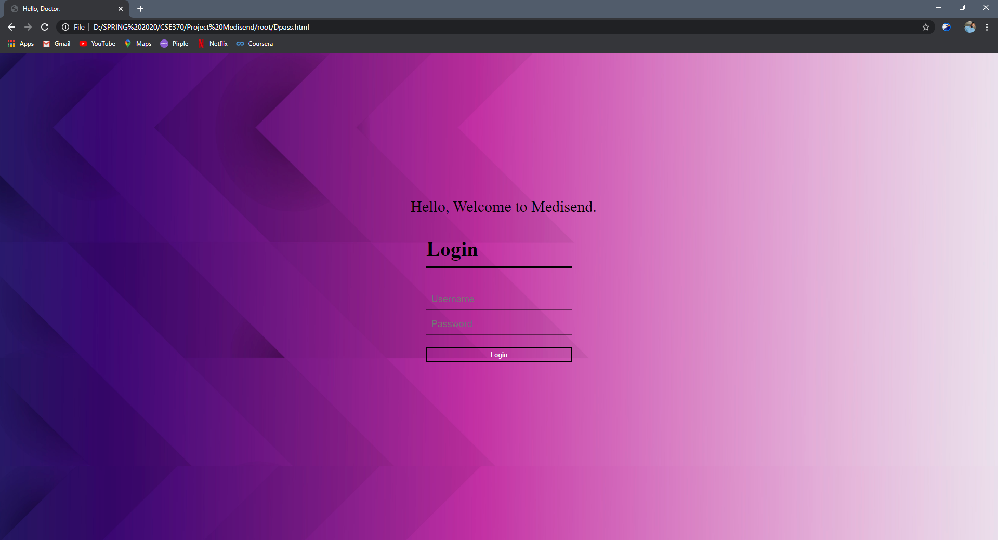
This page takes in the username and the password and links next to the Doctor’s dashboard which contains all the other subpages that accessible by the doctor.

Slide 5

This page takes in the username and the password and links next to the Patient’s dashboard which contains all the other subpages that accessible by the Patient.

Slide 6

This page takes in the username and the password and links next to the Seller’s dashboard which contains all the other subpages that are accessible by the Seller.

Slide 7
All of the above pages are styled using one single CSS file which carries all the necessary classes. I’m attaching the code here in order to avoid cluttering since it is a big file. I have attached the file along with this ppt. The first 95 lines of the line resets the page into a basic page. The rest of the codes are for designing a minimalistic UI for our website for examples: setting the background, the menu bar, and the login interface of the three pages. The name of the file is style.css. Please find the file along with the attachment.

Slide 8
PATIENT’S WINDOW

Slide 9
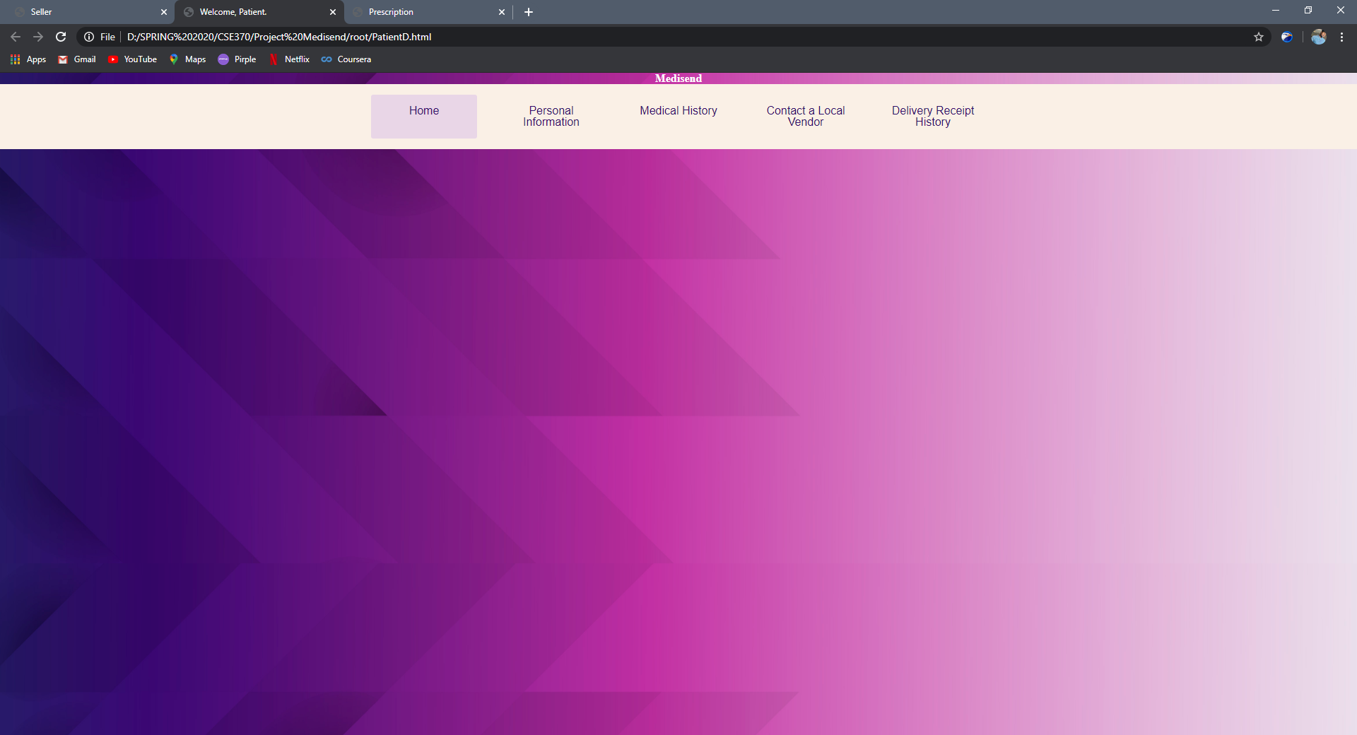
This is the patient’s dashboard. We have used an unordered list to create a menu which was then styled using a CSS file. The dashboard contains personal information of the patient, medical history, a nearby local vendor address and a delivery receipt history showing all the previous deliveries.

Slide 10
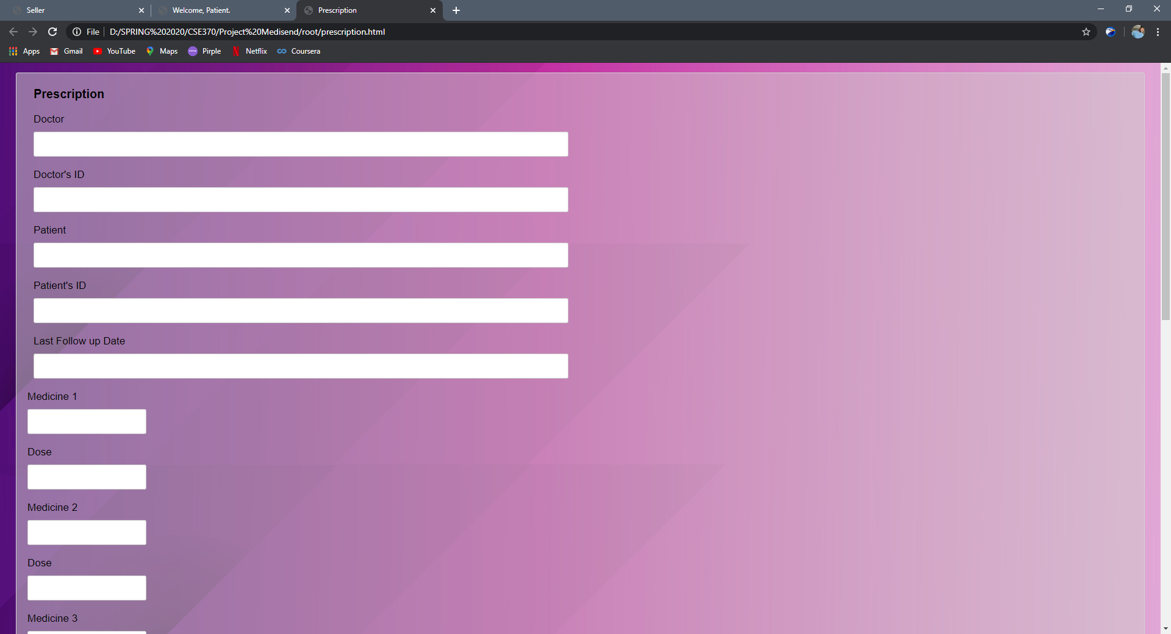
This page produces the prescription that the doctor will provide to the patient. At the end of the prescription, there are two inputs which send this prescription to the patient and the a seller in the same locality as the patient.
This Prescription page was styles using a CSS file. The CSS file is shown and explained in the next page.

Slide 11
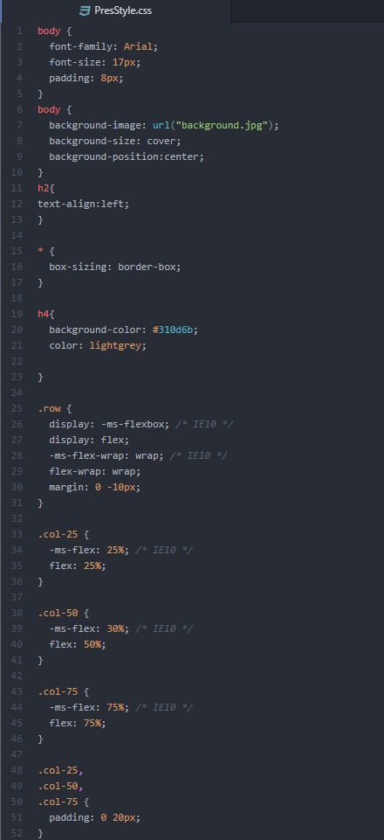
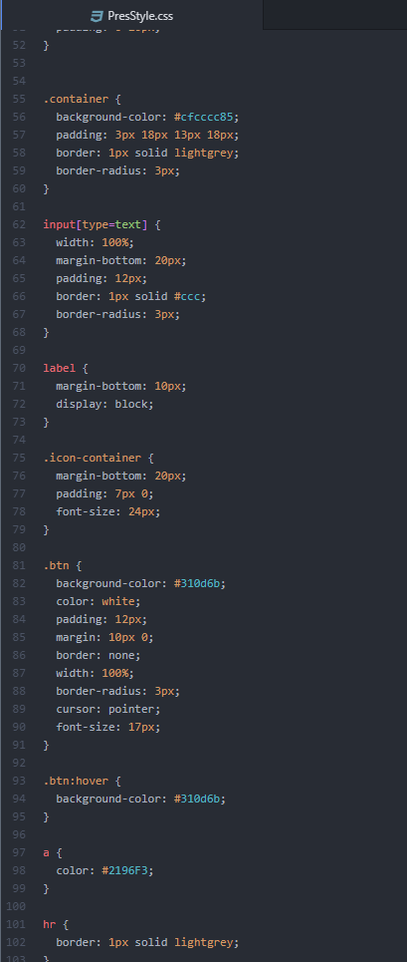
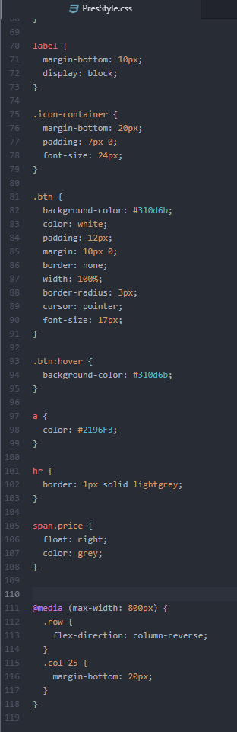
This code styles the prescription that will be provided by the doctor to the patient and the doctor. Addition to the necessary information, the prescription also carries a Dose section which mentions the dose amount of each of the medicine.

Slide 12
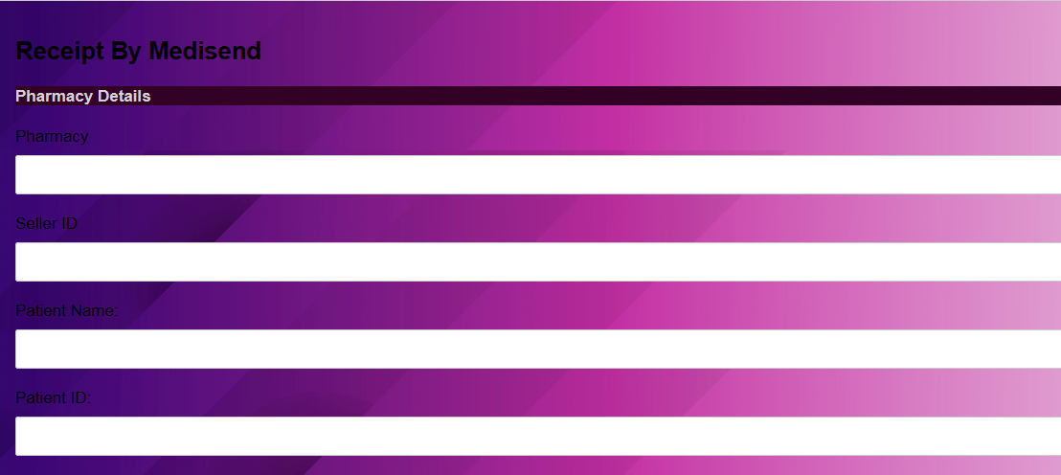
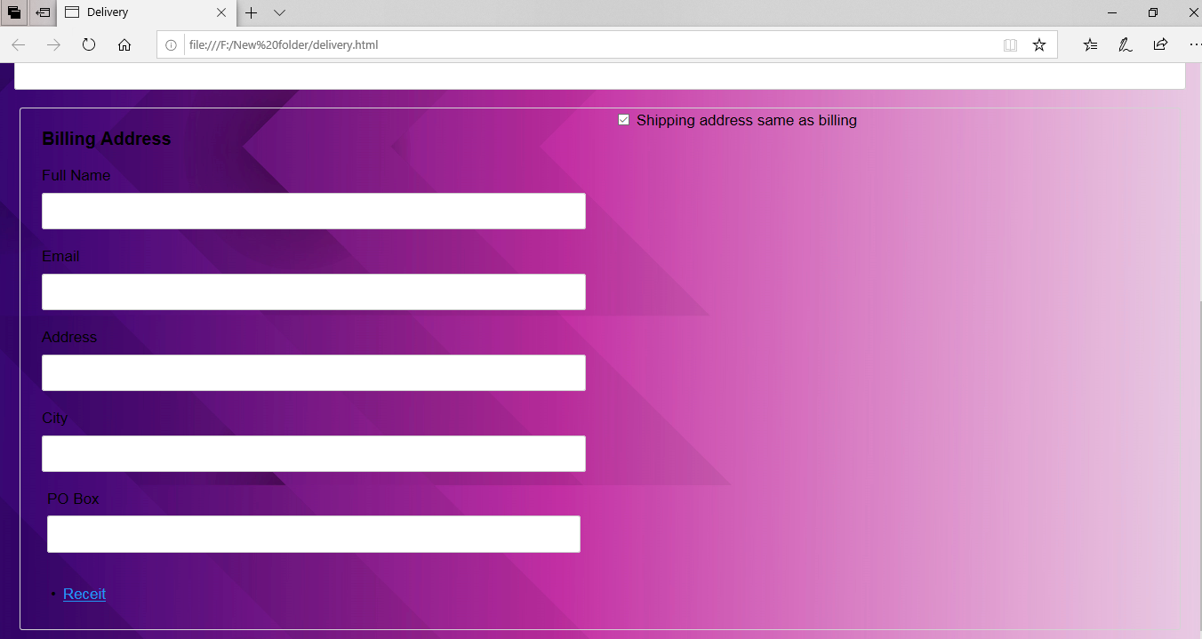
This is delivery page which the patient will receive from the seller. It contains the pharmacy details from which the medicine has been purchased, the seller’s detail who purchased and the patient’s detail(who needs it). This page thereby contains the patients mailing address, that is the address where the medicines have to be delivered. Lastly, the page contains the link to the receipt page which contains the total amount to be paid.

Slide 13
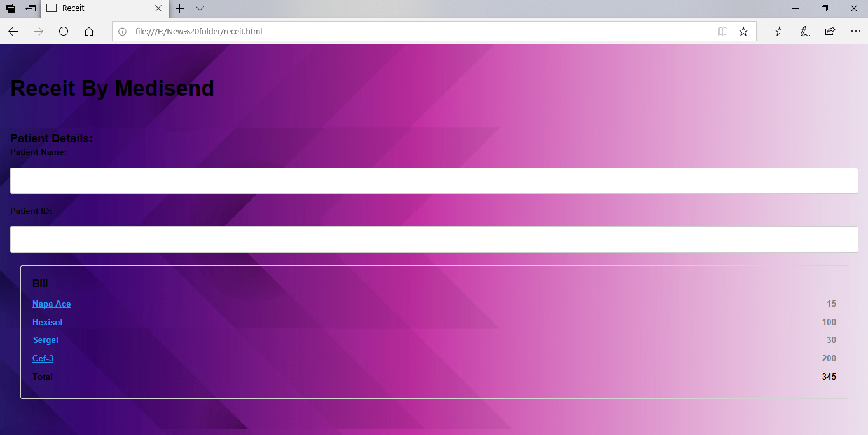
This page shows the patient’s details and the total amount that has to be paid for the required medicines.

Slide 14
DOCTOR’S WINDOW

Slide 15
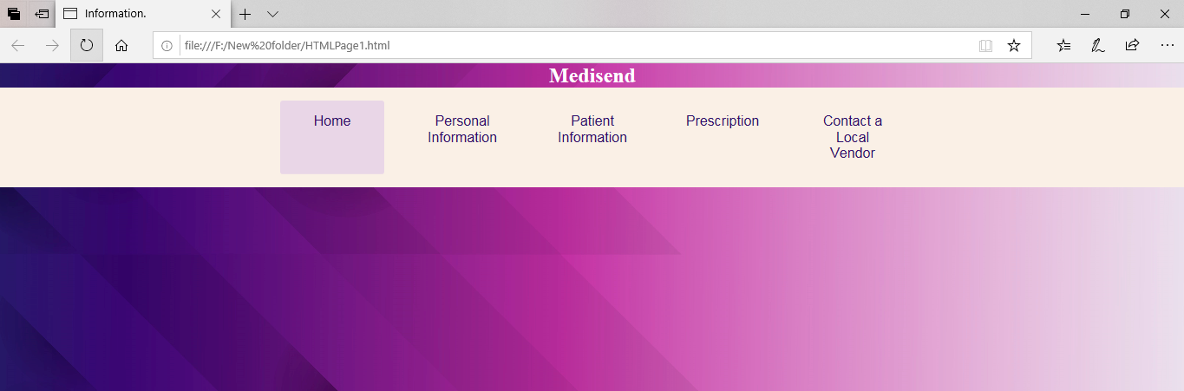
This is the homepage of the doctor. The homepage opens up to a simple log of five other links. Clicking on Home would take us to the doctor’s login page Clicking on Personal Information would take us to the page which has the information of the doctor Clicking on Patient Information would take us to the page that has information of all the patients under that doctor Clicking on Prescription would take us to the page where the doctor can prescribe the medicine Clicking on Contact a Local Vendor would open the page through which the doctor can inform a seller about the medicine being prescribed to the patient.

Slide 16
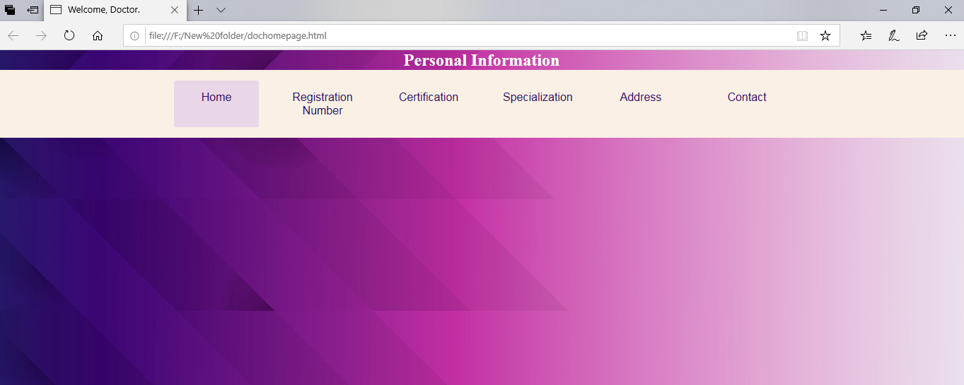
This page gives us all the relative information about the doctor. This page opens up to a simple log of six links. Home takes us back to the Doctor’s information dashboard. Registration number is his licence permit number Certification holds all the degrees and the name of institutions he acquired them from. Specialization is his field of expertise. Address and Contact links contain the chambers address, email address and phone number.

Slide 17
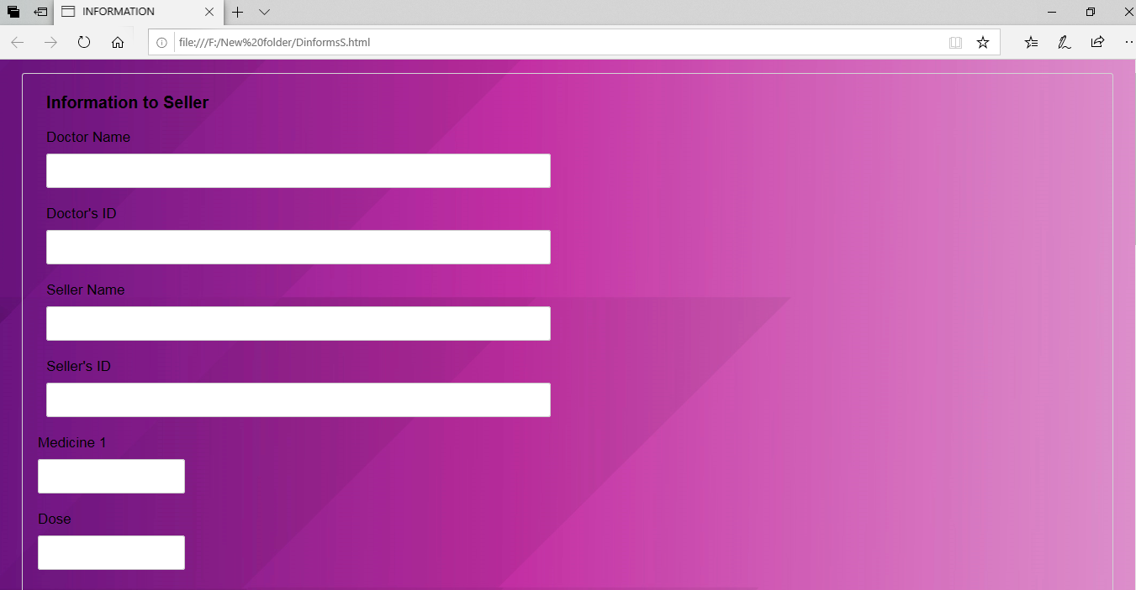
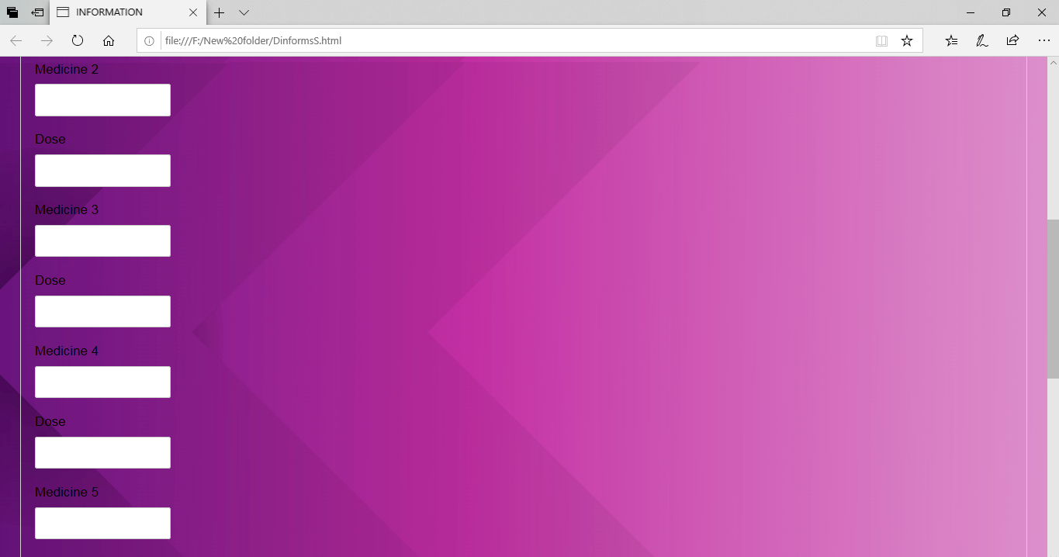
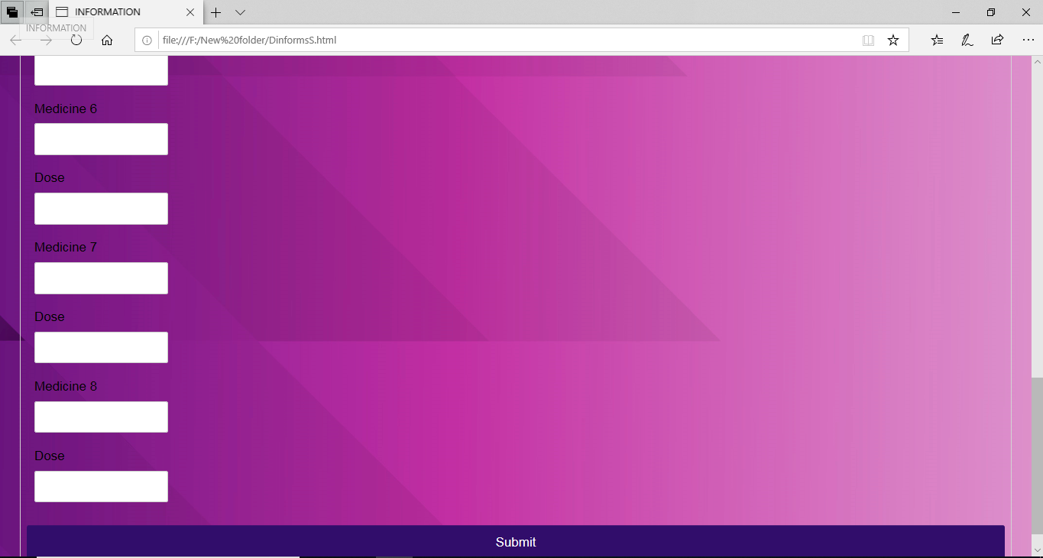
This page is for the doctor to contact a local vendor in order to inform him about the medicines that have been being prescribed to a patient. After filling in the boxes with names od medicines and their does, the doctor will click on the submit button and the seller will then be notified.

Slide 18
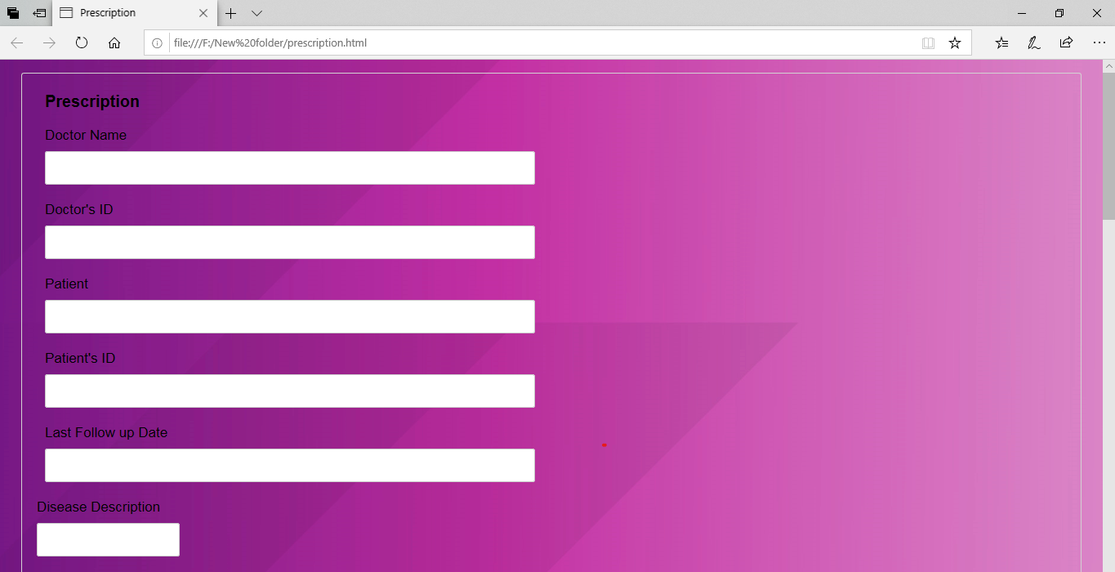


This the prescription page where the doctor will get to know about the patient’s disease in detail. Patient will also be able to inform about his allergies so that the doctor can prescribe medicine accordingly.

Slide 19
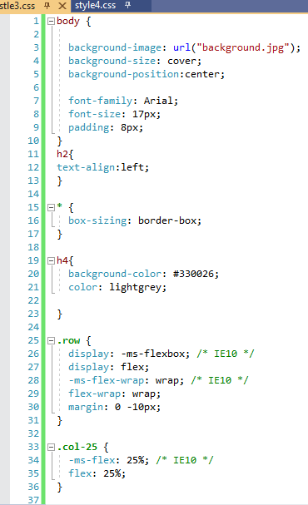
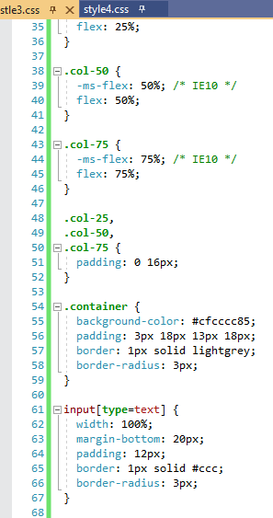
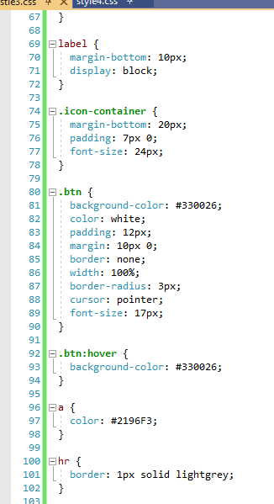
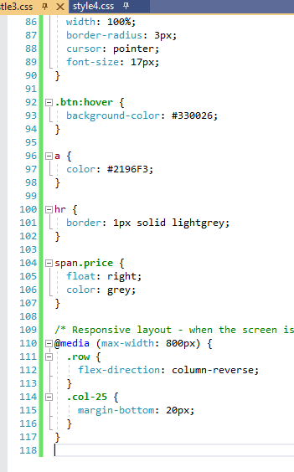
The following codes have been used to style the prescription and delivery pages.

Slide 20
SELLER’S WINDOW

Slide 21
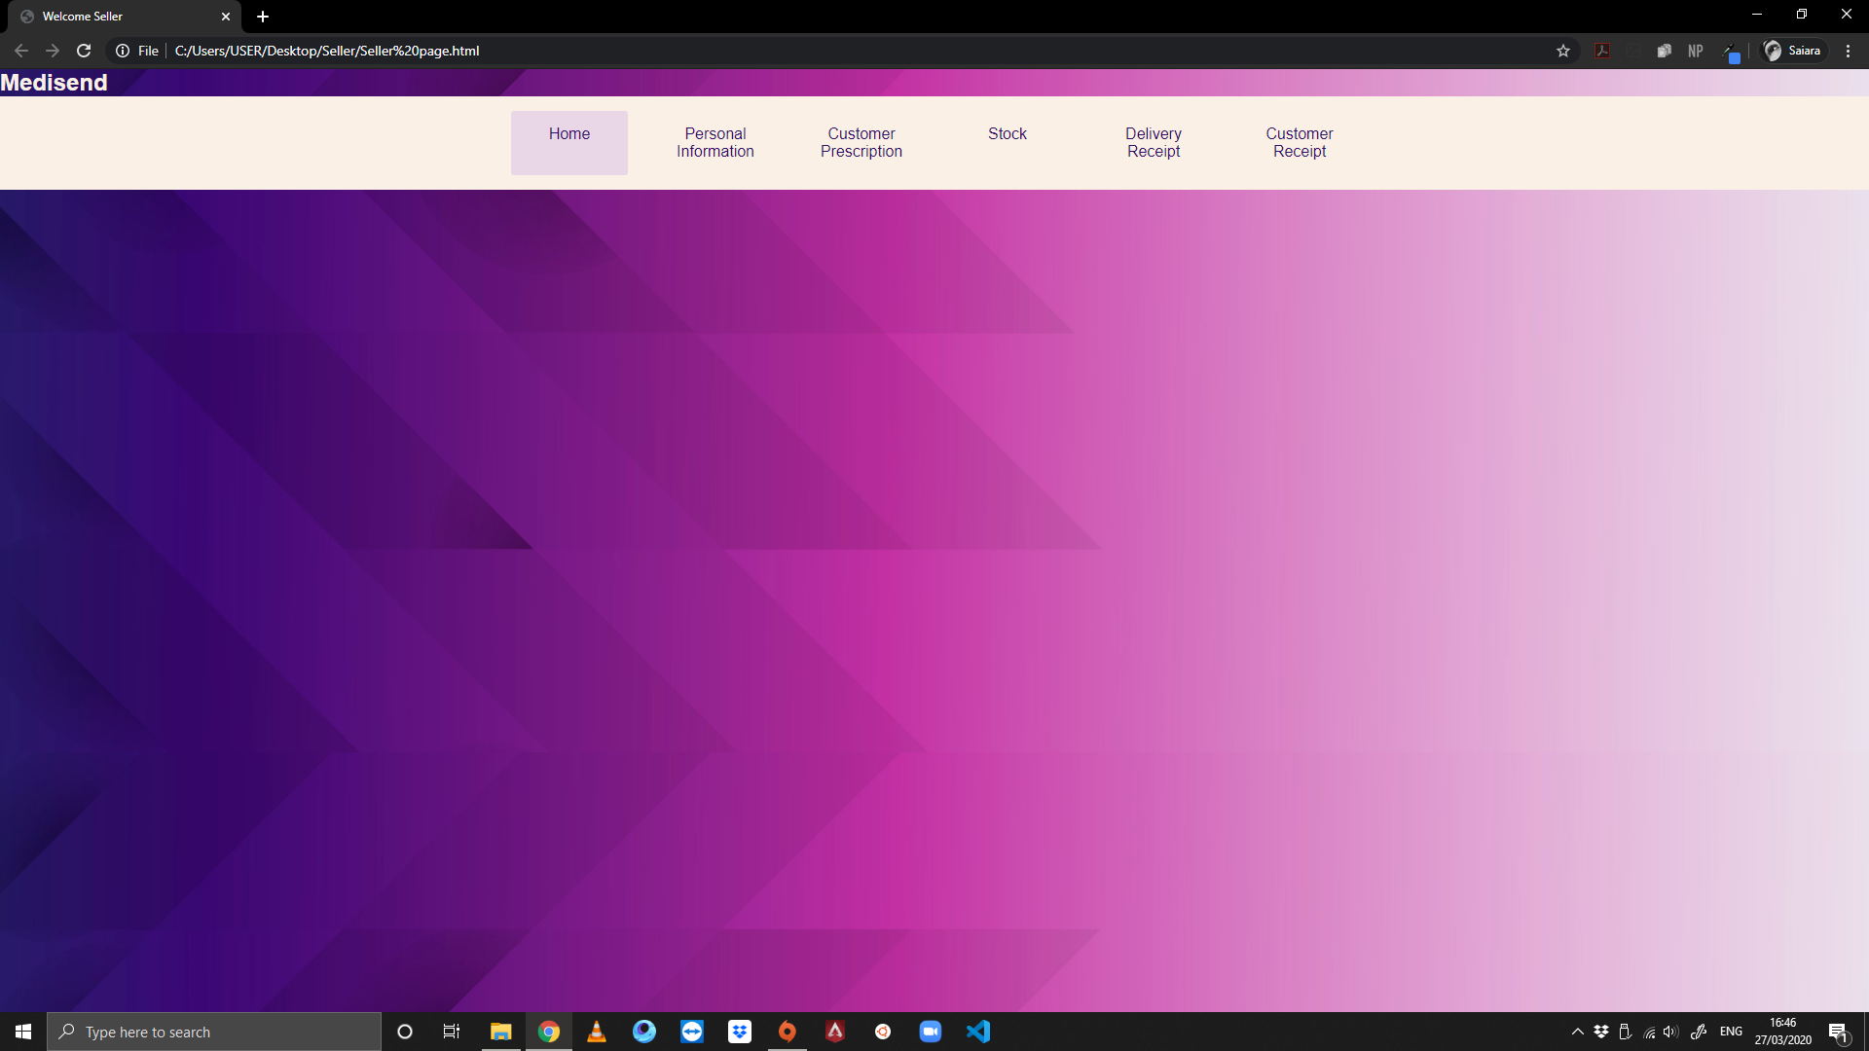
This is the page from which the seller can access various pages according to its need. The navigation bar has a hover effect to allow ease. The home button has been kept active to give it a permanent highlight. In the next slides we can see what each of the pages look like

Slide 22
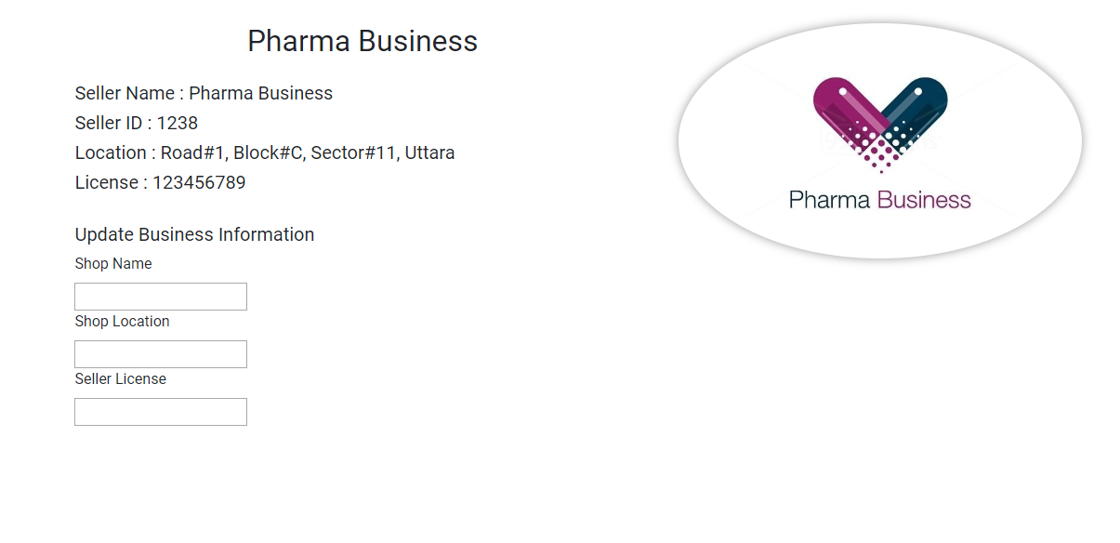
This is the Seller’s Personal Information page from which a particular seller can look for information regarding its own business. There is also an update feature that allows it to update information incase of change of company name, location change and license number change

Slide 23
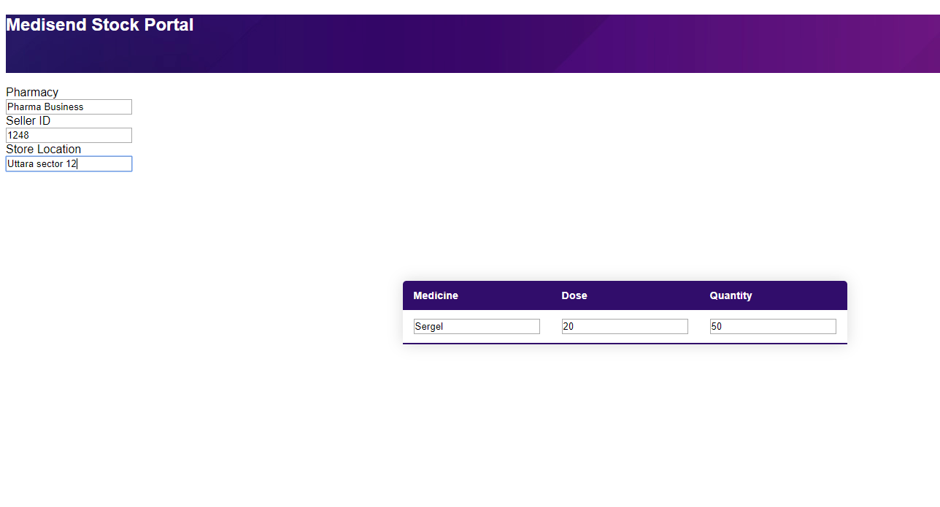
This is the stock view so that sellers
can review their supply stock. Incase, of depleted stock, thy can refer the patient to a nearby pharmacy. It shows just one row, but it will take as many rows it has to depending on the stock table of the Medisend database

Slide 24
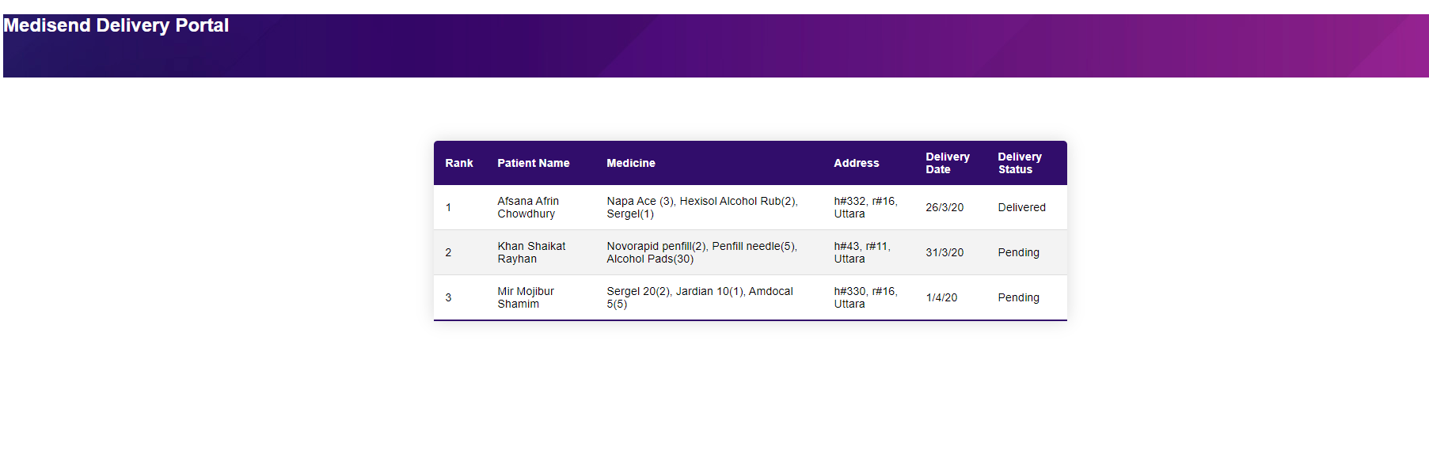
This is the delivery view. It will information regarding what home deliveries were made and what are still left
with details on patient in terms of name, address, medicine with quantity, delivery date and delivery status.

Slide 25
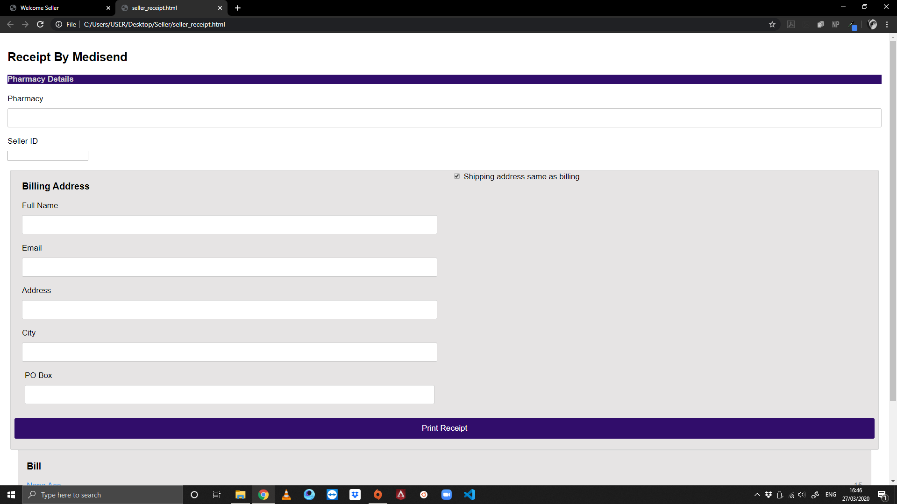
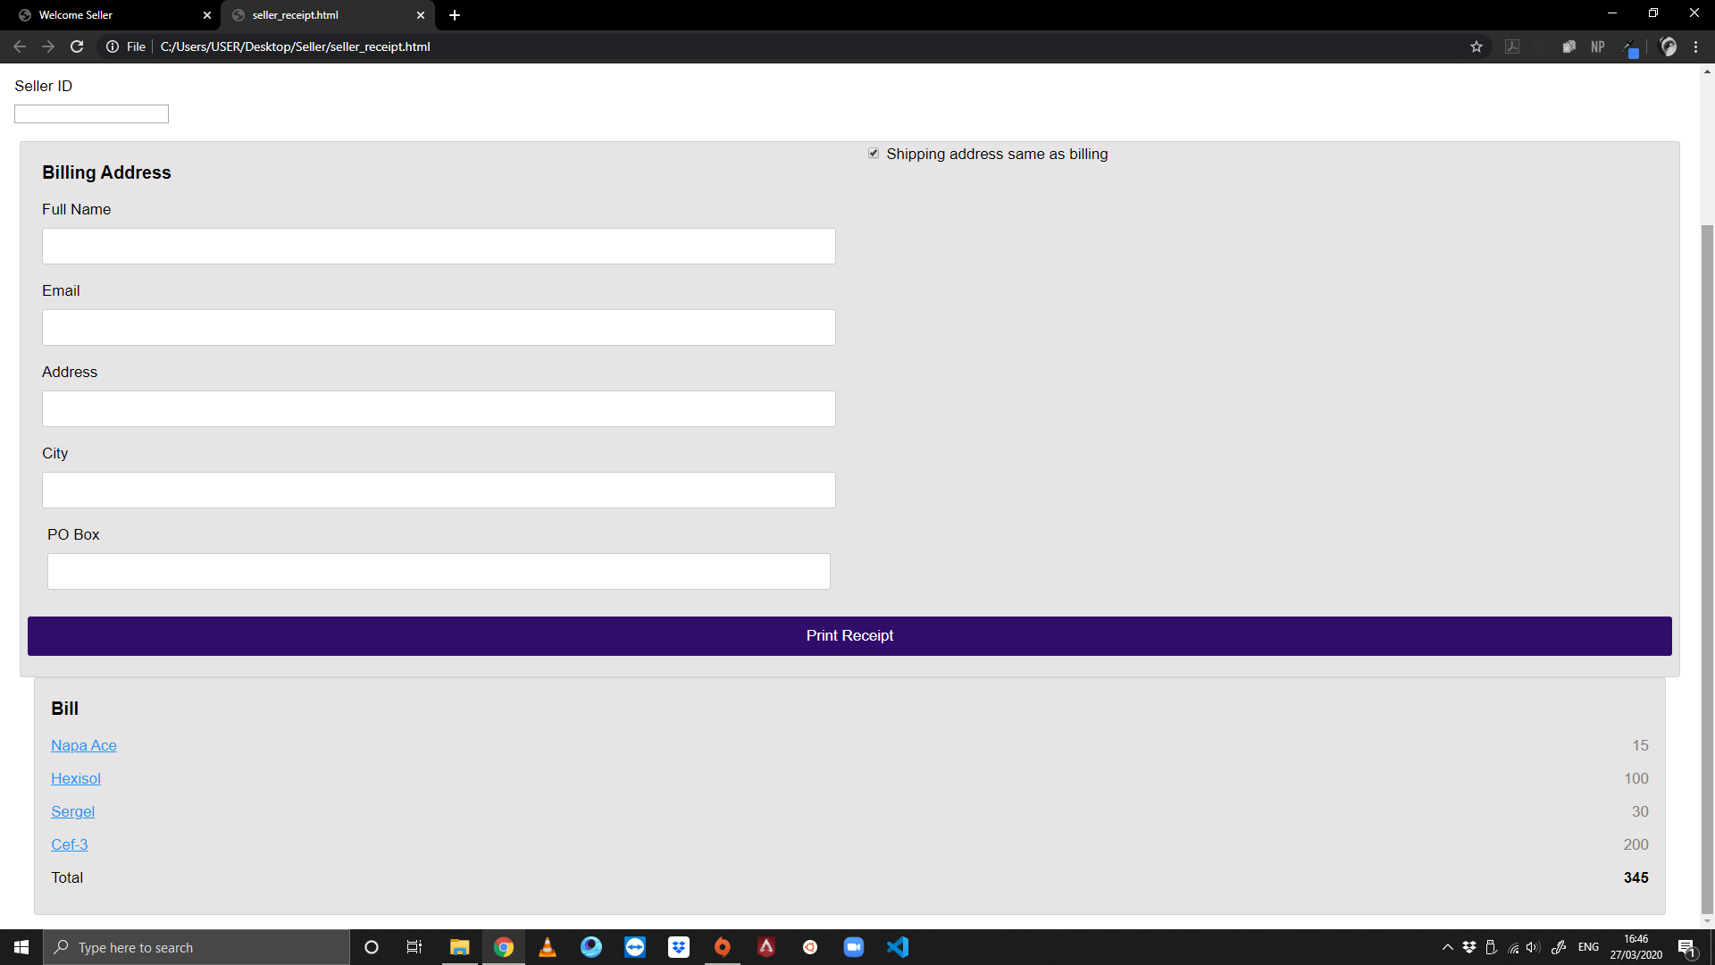
This is the receipt section that will be completed at the pharmacy. It will carry each of the seller’s ID and Pharmacy name. We have kept a checkbox for the billing address. The next section of the billing page is given in the next slide.
This is the bill section which shows
the purchase calculation

Slide 26
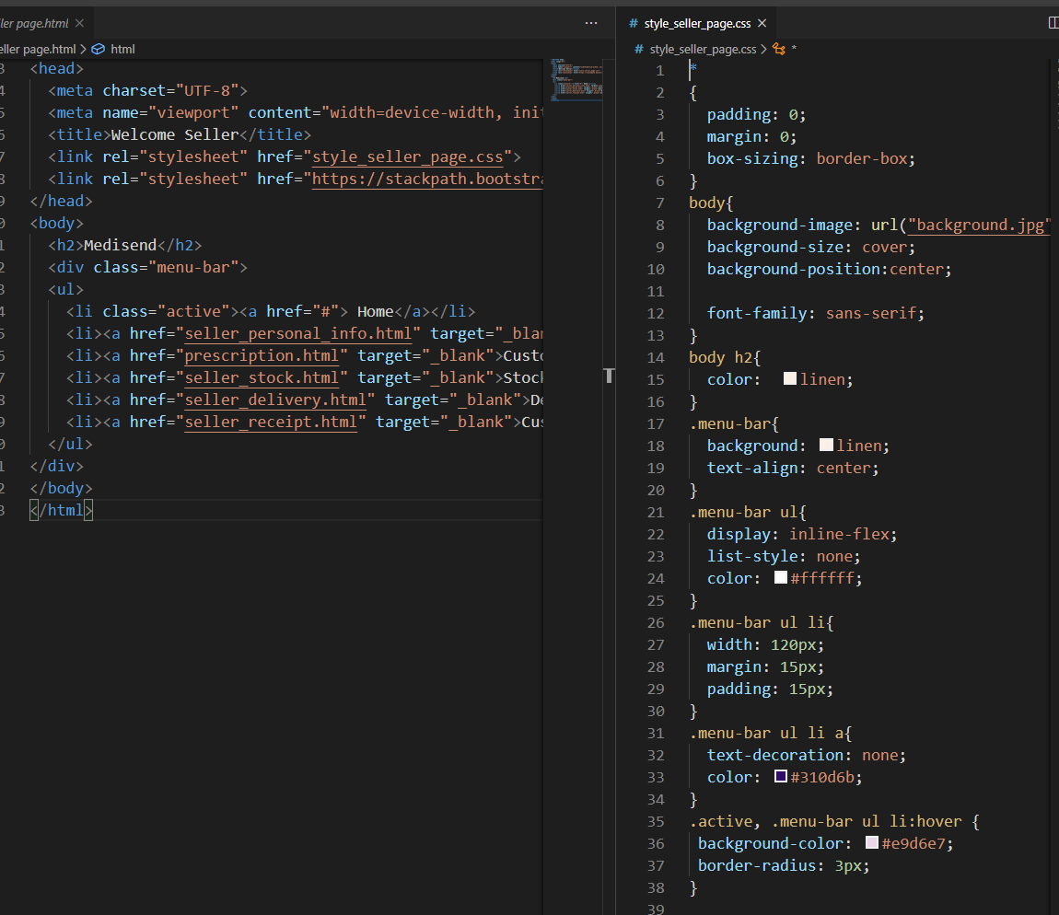
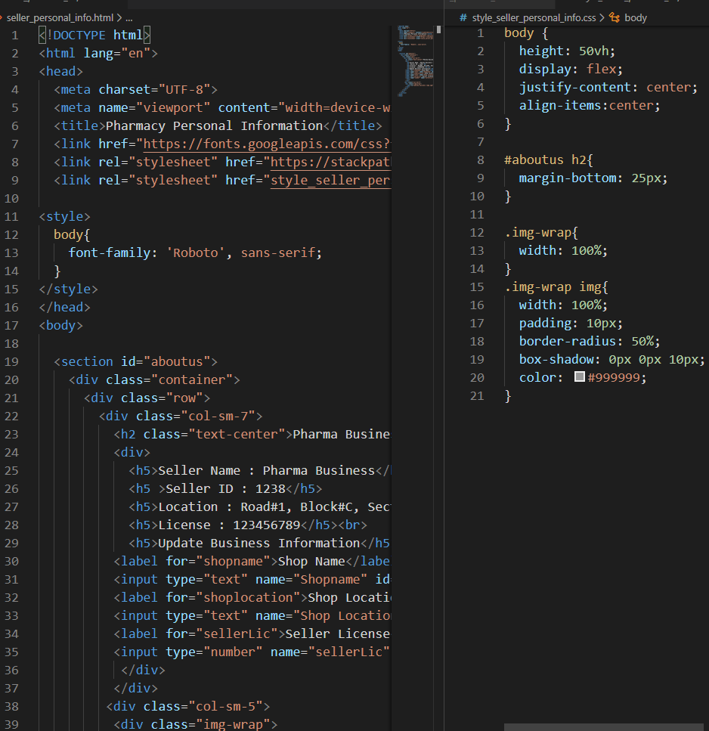
Snippet of Seller Page html and css styling
Snippet of Seller Personal Infomation Page html and css styling

Slide 27
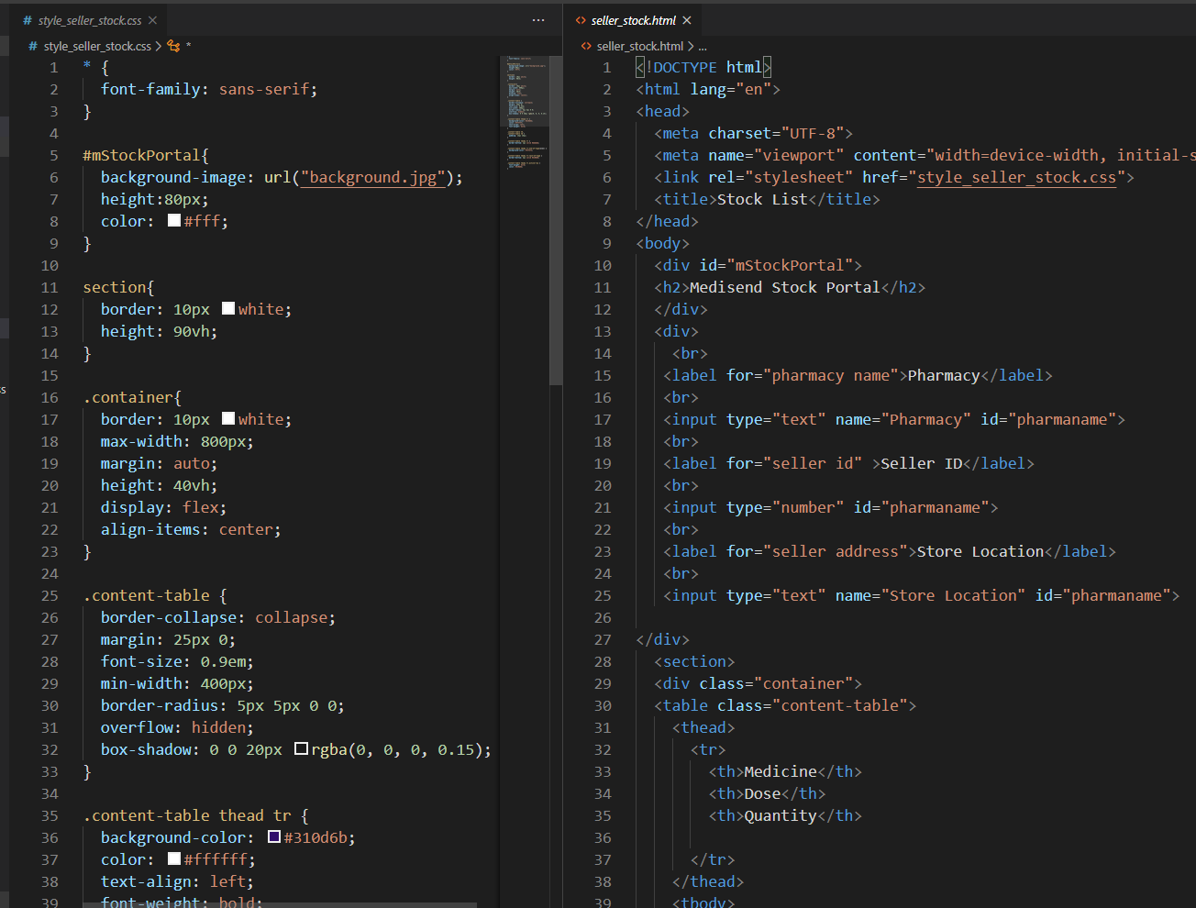
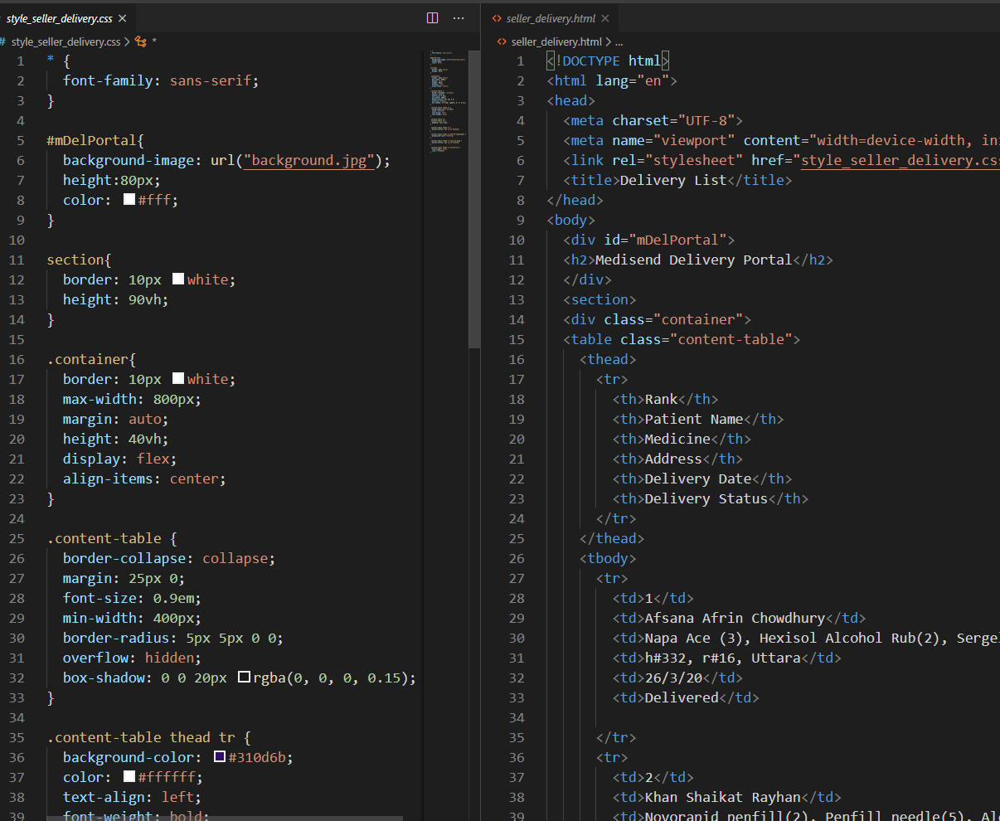
Snippet of Seller Stock
Page html and css styling
Snippet of Seller Delivery
Page html and css styling

Slide 28
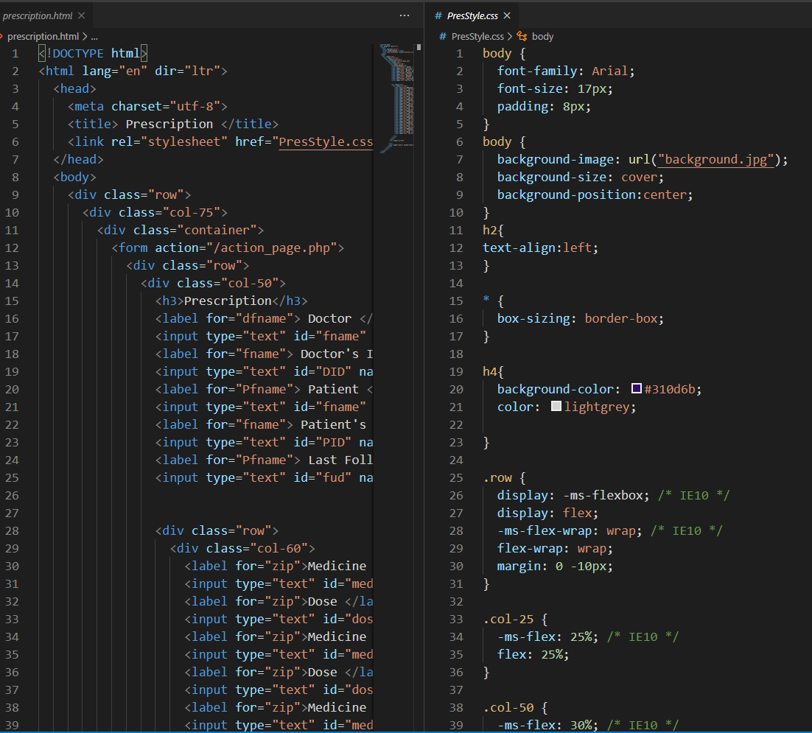
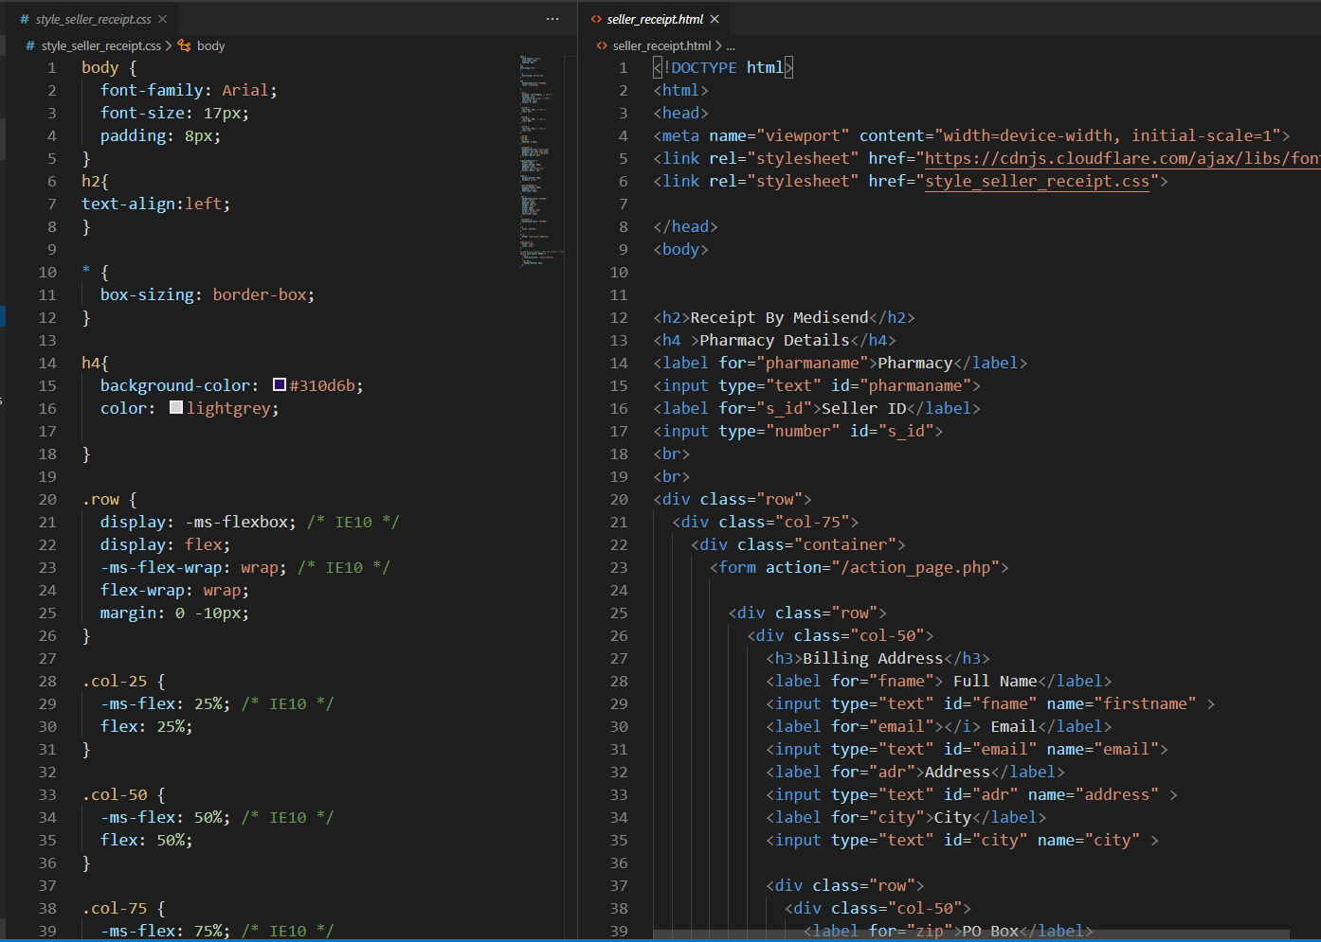
Snippet of Seller Prescription
Page html and css styling
Snippet of Seller’s Customer
Receipt Page html and css styling

Slide 29
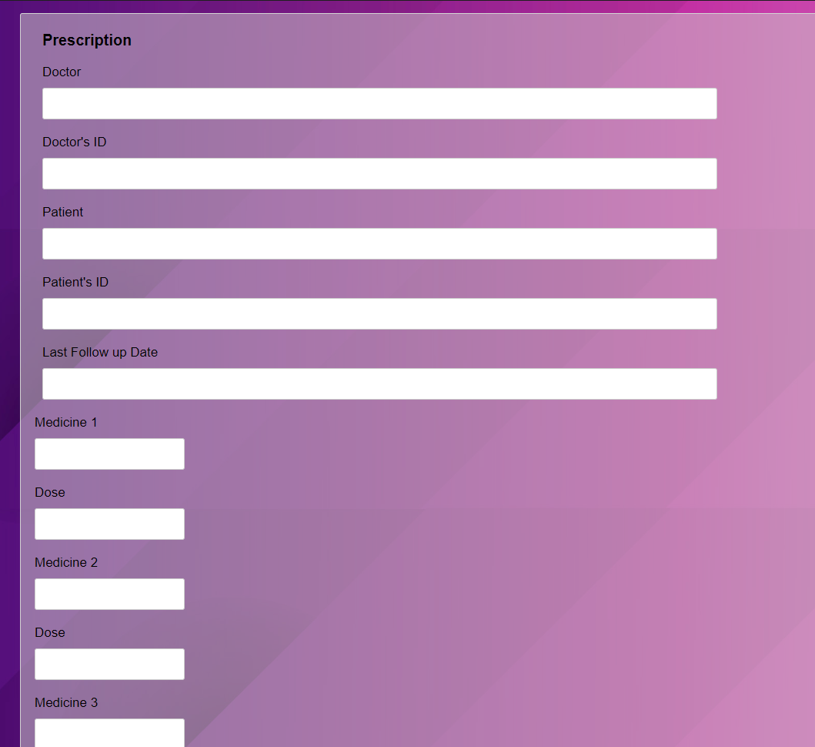
This is the seller’s view of the prescription page Which they can access upon request of patient name. It has the doctor’s necessary information for validation sake to avoid unwanted purchases.

Slide 30
THE END

